Slide 1
Selection statements

Slide 2
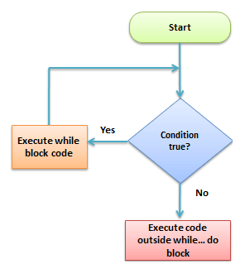
Decision Making
Conditional statements are used in the C programming language for making certain decisions on the basis of the available conditions.

Slide 3
If Statements
Simple else or Null else
If… else
Nested if
Else if ladder

Slide 4
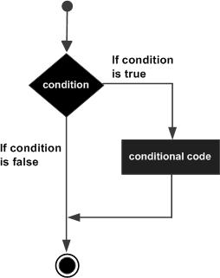
Simple Else or Null Else
This condition occurs when a programmer can skip or execute a set of various instructions on the basis of the condition value.
If (condition1)
{
Statement 1 (s1);
}
Statement 2 (s2);

Slide 5
Simple Else or Null Else Example
#include <stdio.h>
int main ()
{
int a ;
if( a < 20 )
{
printf("a is less than 20\n" );
}
printf("value of a is : %d\n", a);
return 0;
}

Slide 6
If… Else Statement An if statement consists of a Boolean expression followed by one or more statements.
If (condition 1)
{
Statement 1 (s1);
}
else
{
Statement 2 (s2)
}
Statement 3

Slide 7
If… Else Statement Example
#include <stdio.h>
int main ()
{
int a = 100;
if( a < 20 )
{
printf("a is less than 20\n" );
}
else
{
printf("a is not less than 20\n" );
}
printf("value of a is : %d\n", a);
return 0;
}

Slide 8
<=12 - Child
13-19 – Teen
20-35 – adult
36-60 – old
>65 – Very old
>=90 – S
80-89 – A
70-79 – B
60-69 – C
50- 59 –D
<50 - F

Slide 9
Nested If Statement
If (condition 1)
{
If (condition 2)
{
Statement 1 (s1);
}
Else
{
Statement 2 (s2)
}
}
In this case, the condition available in the next if statement (the second statement) will only get evaluated if the evaluation of the condition available in the first statement turns out to be true. This occurs throughout the program that has a nested statement.

Slide 10
Nested If Statement Example
#include <stdio.h>
int main ()
{
int a = 100;
int b = 200;
if( a == 100 )
{
if( b == 200 )
{
printf("Value of a is 100 and b is 200\n" );
}
}
printf("Exact value of a is : %d\n", a );
printf("Exact value of b is : %d\n", b );
return 0;
}

Slide 11
Else If Ladder
If (condition 1)
{
Statement 1 (s1);
}
Else if (condition 2)
{
Statement 2 (s2);
}
else if (condition 3)
{
Statement 3 (s3)
}
…
Else
{
Statement 4 (s4)
}
Statement (s);
In this statement, the execution of an array of instructions occurs only when the available condition is correct. The verification of the next condition occurs when this first condition is incorrect. In case all of the specifications fail even after the verification, then there will be an execution of the default block statements

Slide 12
Else If Ladder Example
#include<stdio.h>
int main()
{
int a,b,c;
printf("Enter three numbers: \n");
scanf("%d%d%d", &a, &b, &c);
if(a>b && a>c)
{
printf("Largest = %d", a);
}
else if(b>a && b>c)
{
printf("Largest = %d", b);
}
else
{
printf("Largest = %d", c);
}
return(0);
}

Slide 13
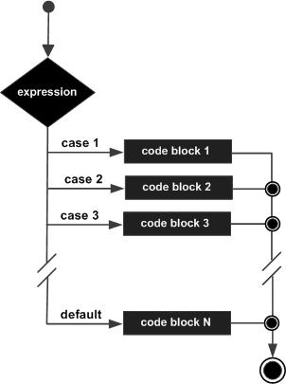
Switch Statements
The C language offers its users with a selection statement in various ways in case a program becomes difficult to read with an increased number of conditions. A switch statement is a multi-way type of selection statement that would resolve this issue.

Slide 14
Switch Statements Syntax
Switch (expression/var)
{
case_A:
Statement A (sA);
Break;
case_B:
Statement B (sB);
Break;
case_C;
Statement C (sC);
Break;
….
case_Z:
Statement Z (sZ);
Break;
Default:
Statement_1 (s1);
Break;
}

Slide 15
Switch Statements Example
#include <stdio.h>
int main ()
{
char grade = 'B';
switch(grade)
{
case 'A' :
printf("Excellent!\n" );
break;
case 'B' :
case 'C' :
printf("Well done\n" );
break;
case 'D' :
printf("You passed\n" );
break;
case 'F' :
printf("Better try again\n" );
break;
default :
printf("Invalid grade\n" );
}
printf("Your grade is %c\n", grade );
return 0;
}

Slide 16
nested switch statements You can use one switch statement inside another switch statement(s).
#include <stdio.h>
int main ()
{
int a = 100;
int b = 200;
switch(a)
{
case 100:
printf("This is part of outer switch\n", a );
switch(b)
{
case 200:
printf("This is part of inner switch\n", a );
case 300:
}
}
printf("Exact value of a is : %d\n", a );
printf("Exact value of b is : %d\n", b );
return 0;
}

Slide 17
Practice Problems
Write a C program to check whether a given number is even or odd
Write a C program to find whether a given year is a leap year or not
Write a C program to find the largest of three numbers
Write a C program to read roll no, name and marks of three subjects and calculate the total, percentage and division.
Write a C program to check whether a triangle is Equilateral, Isosceles or Scalene
Write a C program to check whether a number is positive, negative or zero using switch case.
Write a C program to create Simple Calculator using switch case.

